Slide 1

Data Exercise Freedom Debt Relief’s Marketing Campaign Analysis
Prepared By - Prachir Agrawal
[06/23/2021]

Slide 2
Agenda
Freedom Debt Relief’s Marketing Campaign Analysis
Background / Business Problem 3
Analysis – Data Set Characteristics 4
Analysis – Pre-processing & Features 5
Analysis – EDA 6-7
Tableau Charts and Figures 8-10
Statistical Significance & Matrix Selection 11
Analysis – Key Results & Recommendation 12
Appendix 13-16

Slide 3
Background / Business Problem
Measure marketing campaign and provide strategy for future campaign
Situation
Freedom ran a recent marketing campaign to promote the value proposition of how the debt relief program helps people achieve financial freedom. The cost of this campaign was $5 million. Team Collected the data for pre-campaign, campaign and post campaign months to analyze whether the campaign was successful or not and based on the analysis how we can adjust the future campaigns.
Complication
In order to analyze and come to conclusion we need to explore the data, find out if there are any issues with the data like duplicates, invalid records etc. next step would be exploratory data analysis by defining various statistical methods and related plots. Based on the analysis we will perform a statistical significance test to conclude our findings. Exploratory Data Analysis(EDA)) is very critical step in order to get the insight from the data and choosing right statical method is crucial for the end result.

Slide 4
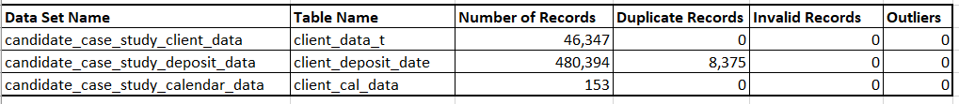
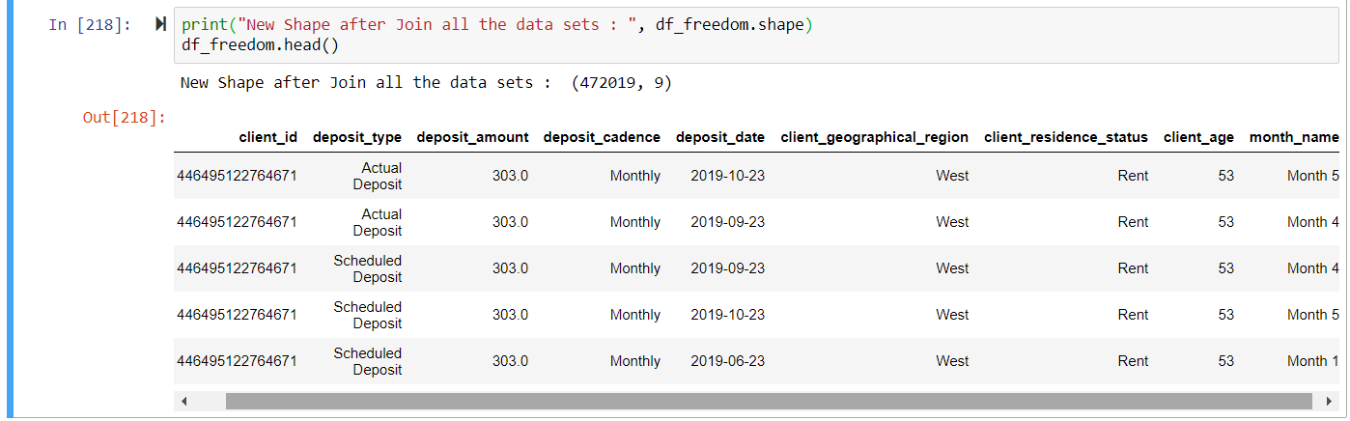
Data Set Characteristics
Dataset Information
Dataset Visualizations

Slide 5
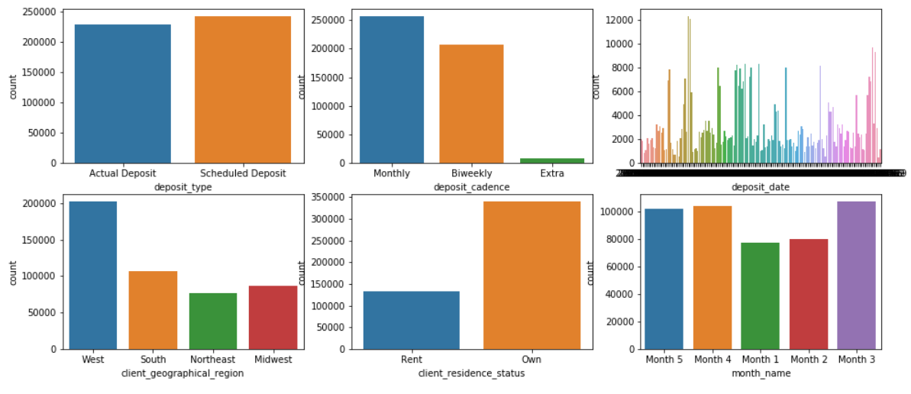
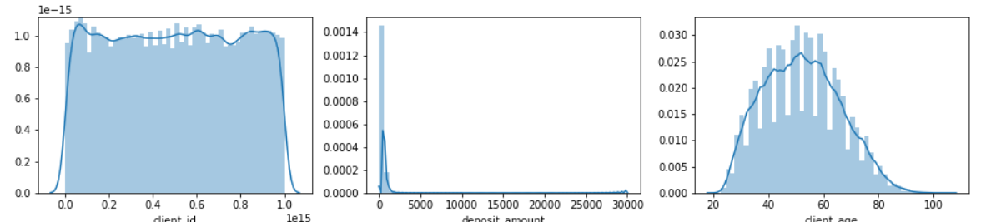
Pre-processing and Feature Analysis Categorical and Numerical Features:
[Display charts, code, data shape, feature description]
Categorical Features
client_geographical_region
client_residence_status
month_name
deposit_type
deposit_cadence
Numerical Features
[Display charts, code, data shape, feature description]
client_id
client_age
deposit_amount

Slide 6
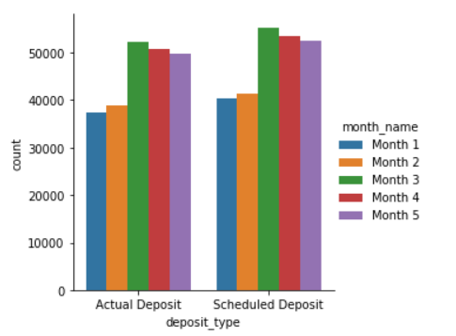
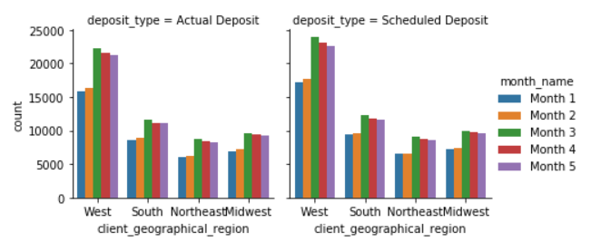
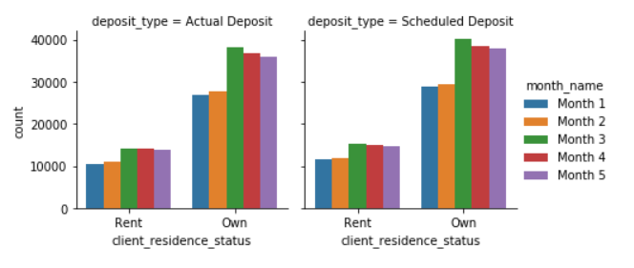
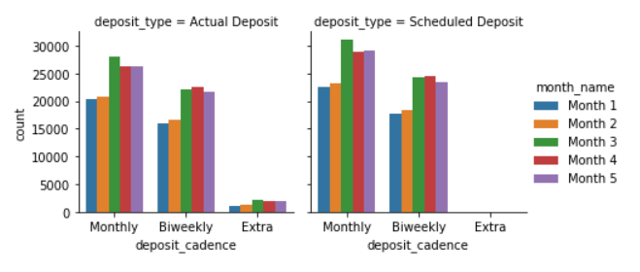
EDA – Exploratory Data Analysis Category plots based on “number of Transactions”
Visualization EDA 1
Visualization EDA 3
[
Visualization EDA 2
Visualization EDA 4

Slide 7
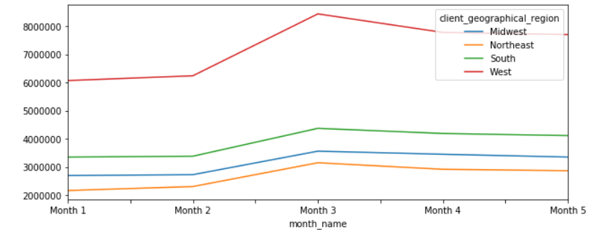
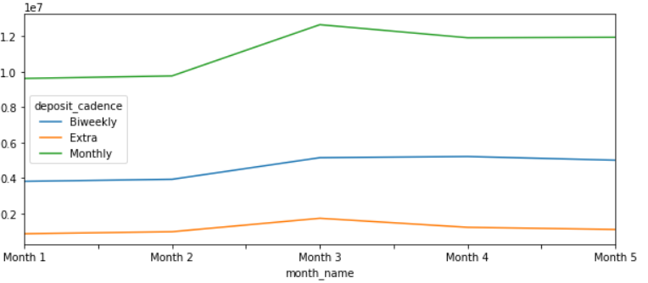
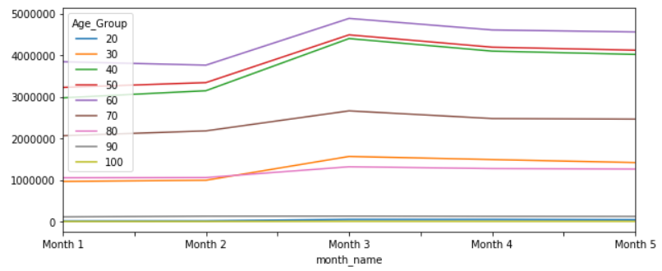
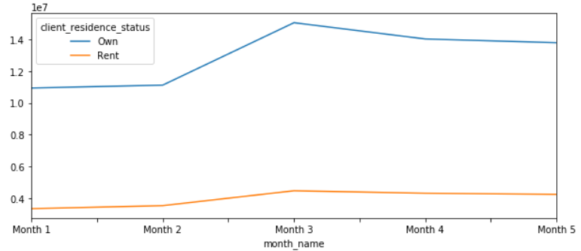
EDA – Exploratory Data Analysis Plots based on “Sum of Deposits” of Actual Amounts
Visualization EDA 5
Visualization EDA 7
[
Visualization EDA 6
Visualization EDA 8

Slide 8
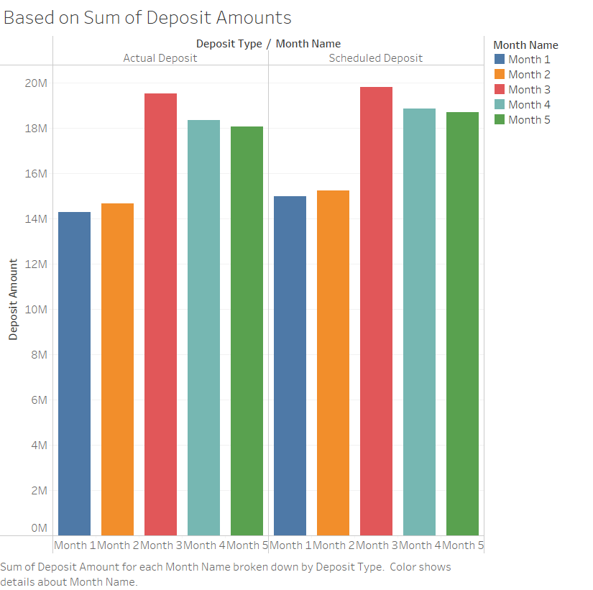
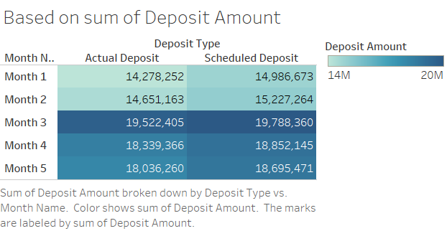
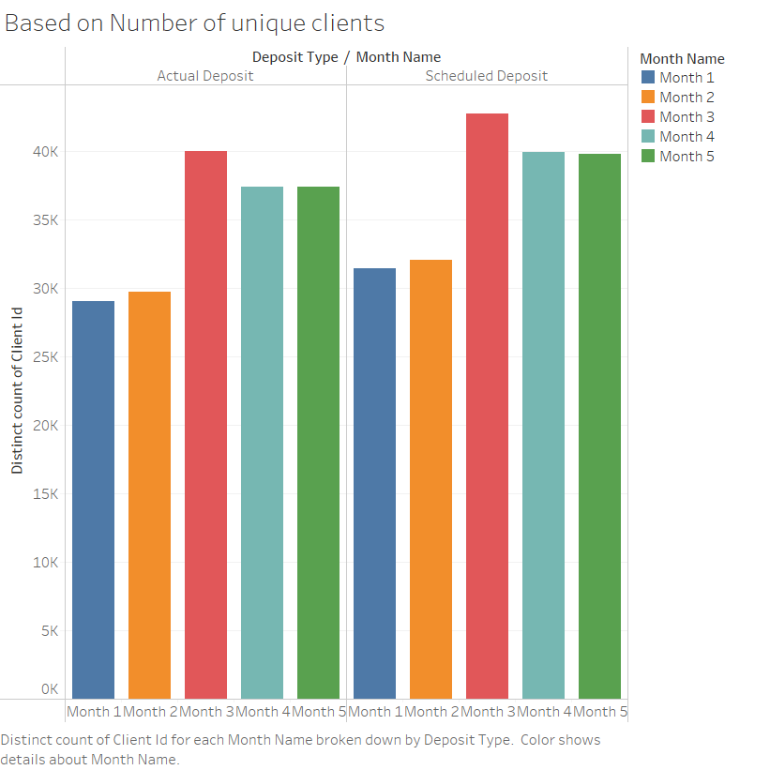
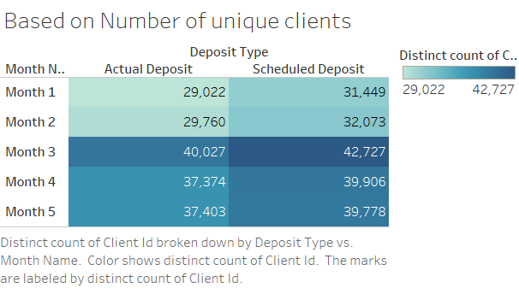
Tableau Charts and Figures To demonstrate deposit amount and number of clients
Tableau Chart 1
[
Tableau Chart 2

Slide 9
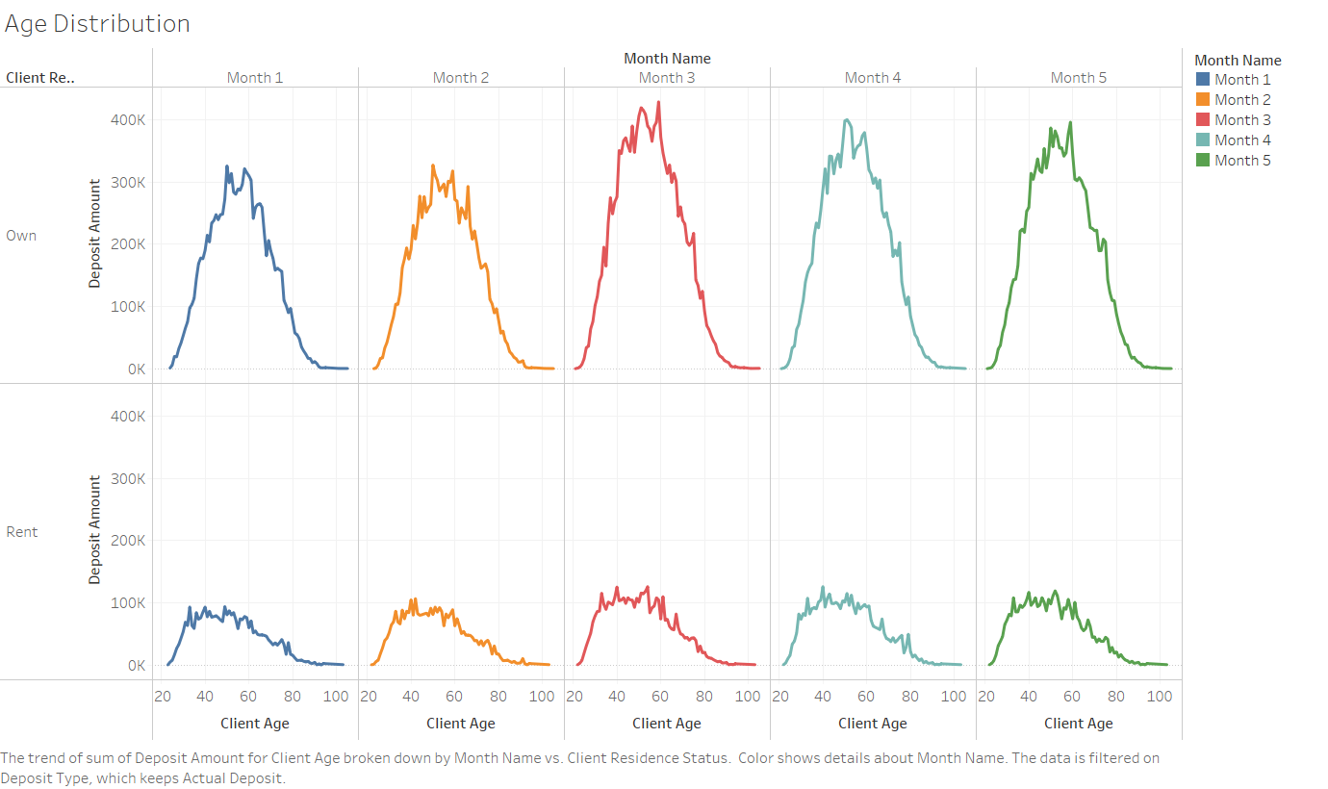
Tableau Charts and Figures To demonstrate Age and Client Residence Status Factors
Tableau Chart 3
[

Slide 10
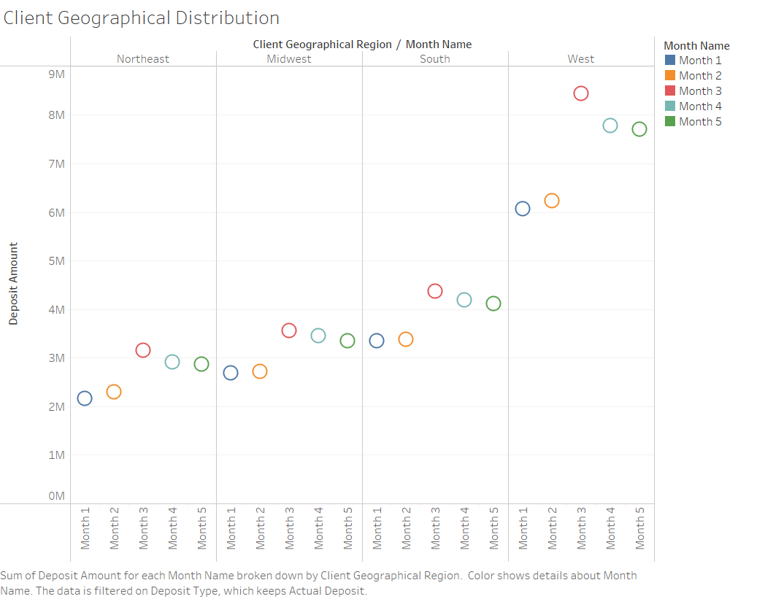
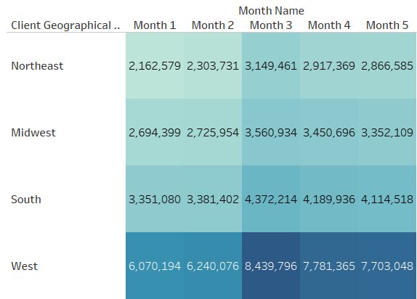
Tableau Charts and Figures To demonstrate Client Geographical Region Factor:-
Tableau Chart 4

Slide 11
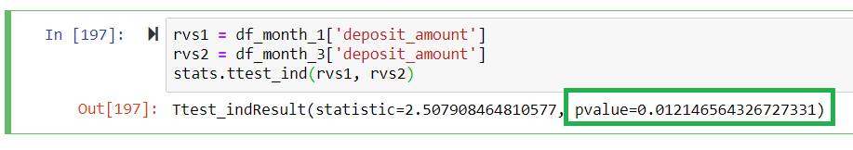
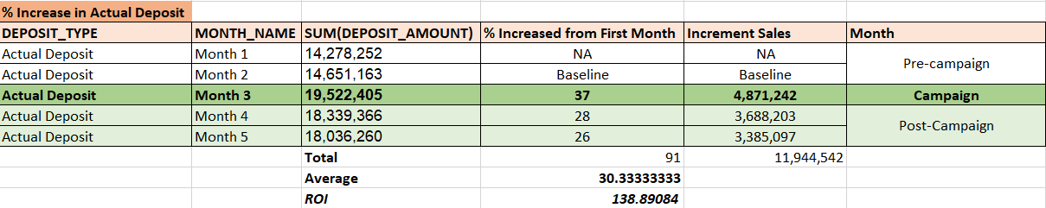
Statistical Significance & Matrix Selection
Statistical Significance Evaluation
Statistical Significance p Value Test
Control Group Sample - Month 1 Pre-Campaign data
Test Group Sample - Month 3 Campaign data
As we have observed below that p Value is less than 0.05 so we can reject the control group.
Matrix Selection and Calculations
Incremental Sales ($) = Total Sales ($) - Baseline Sales ($)

Slide 12
Analysis Results & Recommendations Campaign was Successful
Result of the Campaign
With the Incremental Sales Matrix, Exploratory Data Analysis and Statistical Methods we can comfortably conclude that Campaign was successful.
We observed average 30% increase in the deposit amounts, and also during campaign, we have added around 11,500 new customers.
Strategy of future Campaign
Below are few points to consider for Future Campaign:-
Target Age Customer – 40 Years to 60 Years
Residential Status – Own a Residence
Client Geographical Region – West
Also, with above factors we can adjust out campaign so we can attract to more prospects from low traffic regions and Age Groups.
Additional Remarks
In order to perform detail analysis, we need more durations of the data and few more data points.
12 Months of Data to analyze.
Target variable so we can build prediction model for future campaign
Channel Mix Information

Slide 13
Appendix

Slide 14
Assumptions
There is no seasonality in the results, and the campaign spend was distributed evenly across Month 3 (e.g., spend on the first day is the same as spend on the last day)
Channel mix, targeting, and efficiency are outside the scope of this exercise, but may be addressed as part of Question #4.
There may be data provided that is not useful in your end presentation.
Duplicate Records identified and removed based on the transaction logic.

Slide 15
Data Analysis Approach
1. Understand the problem
Never forget which business problem you are trying to solve and the business objectives.
2. Explore the data
Exploratory data analysis to understand the quality of the data (i.e. missing fields), the shape of the data (size, number of features, type of features), the statistic profile of the data (i.e. outliers, distribution etc.)
3. Cleanse the data
Clean any data quality issues garbage in, garbage out
4. Preprocess the data
Transform the data or engineer new features if necessary to gain more insights
5. Metrics and Modeling
Model creation, evaluation and selection
Code is clean, easy to read and the analysis is repeatable
6. Evaluate findings
Are they logical and do they make sense? Is the modeling approach used appropriate?
7. Iterate and Refine
Refine analysis and fine tune models and findings
8. Communicate clearly
Simple and straightforward messaging linking the results to the business outcome.
Assumptions stated.

Slide 16






Development Environment
This Case Study I have performed on my personal laptop – Window OS
[insert GitHub link to code]
Python
Libraries: Scikit-Learn, Pandas etc.
SQL
Code
Windows,
Linux
Anaconda
SQL Developer
Environment
Seaborn,
Plotly
Tableau
Visualization
CSV
Oracle DB
Cloud AWS
Other
Data

